Slide 1
Configuring zones in DNS

Slide 2
Executive summary
Purpose
Layout
Style
The executive summary should be a brief, stand-alone version of a document that focuses on the most important messages, meant to be read rather than presented.
Do not include any content that is not in the body of the document.
Use the columns in this layout to organize the content.
If you need more than 3 columns, use two rows or add a second page.
Be brief. Write the shortest, simplest sentences possible.
Favor active over passive verbs.
Use plain words and the client’s terminology, not consulting jargon.
Source: …

Slide 3
Agenda
DNS resource record types
Creating records in DNS
Configuring DNS zones
Primary zone vs secondary zones vs. stub zone vs. AD-integrated zone
Zone replication

Slide 4
DNS resource record types
Resource records specify a resource type and the IP address to locate the resource.
Resource records also help find resources for a particular domain. For instance, when an Exchange server needs to find the server that is responsible for delivering mail for another domain, the Exchange server will request that domain’s mail exchange (MX) record, which points to the A record of the host that is running the Simple Mail Transfer Protocol (SMTP) mail service.
Resource records also can contain custom attributes. MX records, for instance, have a preference attribute, which is useful if an organization has multiple mail servers. This will inform the sending server which mail server the receiving organization prefers. Service locator (SRV) records also contain information regarding which port the service is listening to and the protocol that you should use to communicate with the service.

Slide 5
DNS resource record types
DNS resource records | Description
Start-of-authority (SOA) resource record | identifies the primary name server for a DNS zone, in addition to other specifics, such as Time to Live (TTL) and refresh.
Host address (A) resource record | resolves a host name to an IPv4 address.
Canonical name (CNAME) resource record | An alias record type that maps one name to another (for example, www.microsoft.com is a CNAME of the A record microsoft.com).
MX resource record | Specify an email server for a particular domain.
SRV resource record | Identifies a service that is available in the domain. Active Directory uses these records extensively.
Name server (NS) resource record
AAAA | resolves a host name to an IPv6 address.
Pointer (PTR) resource record | look up and map an IP address to a domain name. The reverse lookup zone stores the names.

Slide 6
Agenda
DNS resource record types
Creating records in DNS
Configuring DNS zones
Primary zone vs secondary zones vs. stub zone vs. AD-integrated zone
Zone replication

Slide 7
Creating records in DNS
Dynamic creation
When dynamic updates are allowed for a DNS zone, clients that use DNS will register with the DNS server, and then the resource records for each client are created automatically. This configuration is known as dynamic updates.
Manual creation
If dynamic updates are not enabled for a DNS zone, you must create resource records manually. Even
when dynamic updates is enabled, you must still manually create some records. Alias, or CNAME records, for example, are commonly created manually to provide an alias DNS name for a node on the network

Slide 8
Creating records in DNS
Using DNS Manager console
Right-click the zone, and then click one of the following: New Host, New Alias, New Mail Exchanger, or Other New Records.
Type a host name for the new record, and fill in the other details for the record, depending on the record type.
Using Windows PowerShell cmdlets:
• Add-DnsServerResourceRecord. Creates any resource record, specified by type.
• Add-DnsServerResourceRecordA. Creates a type A resource record.
• Add-DnsServerResourceRecordCNAME. Creates a CNAME alias resource record.
• Add-DnsServerResourceRecordMX. Creates an MX resource record.
• Add-DnsServerResourceRecordPtr. Creates a PTR resource record.

Slide 9
Agenda
DNS resource record types
Creating records in DNS
Configuring DNS zones
Primary zone vs secondary zones vs. stub zone vs. AD-integrated zone
Zone replication

Slide 10
Forward lookup zone
The forward lookup zone resolves host names to IP addresses and hosts the common resource records:
A, CNAME, SRV, MX, SOA, TXT, and NS. This zone type must exist for a DNS zone to be considered
authoritative. Client computers send host names or FQDNs of the DNS server’s domain to the DNS server.
The DNS server uses the FQDN to look up a corresponding IP address or to find any resource record type
that the client prescribes, such as a domain controller’s SRV records. The DNS server returns the IP address or addresses to the client in the DNS response.
Reverse lookup zone
The reverse lookup zone resolves an IP address to a domain name, and hosts start of authority (SOA),
name server (NS), and pointer (PTR) resource records. Reverse zones are not always configured, but you should configure them to reduce warning and error messages. Many standard Internet protocols rely on reverse zone lookup data to validate forward zone information. For example, if the forward lookup indicates that training.contoso.com
resolves to 192.168.2.45, you can use a reverse lookup to confirm that 192.168.2.45 is associated with training.contoso.com.
If you see suspicious activity from a particular IP address, you can resolve the host by using the reverse lookup zone information. Many email security gateways use reverse lookups to validate that the IP address that is sending messages is associated with a domain.

Slide 11
Agenda
DNS resource record types
Creating records in DNS
Configuring DNS zones
Primary zone vs secondary zones vs. stub zone vs. AD-integrated zone
Zone replication

Slide 12
Primary zone vs secondary zones vs. stub zone vs. AD-integrated zone
Primary zone
When the DNS server is both the host and the primary source for information about a zone, the zone is a primary zone. In addition, the DNS server stores the master copy of the zone data either in a local file or in AD DS.
When the DNS server stores the zone data in a file, the primary zone file by default is named zone_name.dns, and is located on the server in the %windir%\System32\Dns folder.
When the zone is not stored in AD DS, the primary zone server is the only DNS server that has a writable copy of the database.
Secondary zone
When the DNS server is the host, but is the secondary source for zone information, the zone is a
secondary zone. The zone information at this server must be obtained from another DNS server that
also hosts the zone.
This DNS server must have network access to the DNS server to receive updated zone information. Because a secondary zone is a copy of a primary zone that another server hosts, the secondary zone cannot be stored in AD DS. Secondary zones can be useful if you are replicating data from non-Windows DNS zones.

Slide 13
Primary zone vs secondary zones vs. stub zone vs. AD-integrated zone
Stub zone
A stub zone is a replicated copy of a zone that contains only those resource records necessary to identify
that zone’s authoritative DNS servers.
Active Directory–integrated zone
If AD DS stores the zone data, DNS can use the multi-master replication model to replicate the primary
zone data. This enables you to simultaneously edit zone data on more than one DNS server.

Slide 14
Agenda
DNS resource record types
Creating records in DNS
Configuring DNS zones
Primary zone vs secondary zones vs. stub zone vs. AD-integrated zone
Zone replication

Slide 15
Zone replication
Zone transfers
To transfer zone records from a master server to a secondary server. A master server can be any other DNS server that loads the zone, such as the primary server for the zone or another secondary server. When the master server receives the request for the zone, it can reply with either a partial or a full transfer of the zone to the secondary server.
Full zone transfer. occurs when you copy the entire zone from one DNS server to another. A full zone transfer is known as an all zone transfer (AXFR).
Incremental zone transfer. occurs when there is an update to the DNS server and only the resource records that were changed are replicated to the other server. This is known as an incremental zone transfer (IXFR).
Fast zone transfer. Windows DNS servers perform fast transfers, which are a type of zone transfer that uses compression and sends multiple resource records in each transmission.
Zone replication
Active Directory replication provides an advantage over standard DNS replication.
With standard DNS replication, only the primary server for a zone can modify the zone.
With AD DS replication, all DCs for the domain can modify the zone and then replicate the changes to other DCs. This replication process is known as multi-master replication because multiple DCs, or masters, can update the zone.
Active Directory–integrated zones replicate by using multi-master replication. This means that any standard DCs that also holds the DNS role can update the DNS zone information, which then replicates to all DNS servers that host the DNS zone.

Slide 16
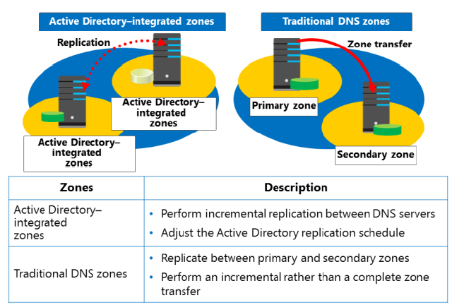
Zone replication

